Slide 1


Cache
Haijian Sun
sunh@uww.edu

Slide 2
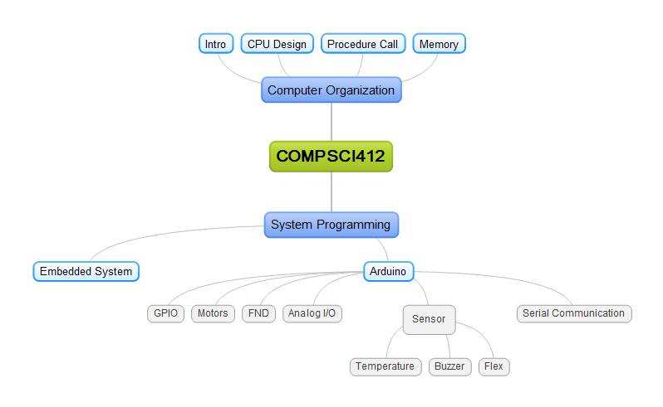
Learning Object
Cache
Cache Hit/ Miss
Locality in Memory
Temporal Locality
Spatial Locality

Slide 3
Memory Hierarchy
Register
Storage in CPU
Cache
S-RAM
Close to CPU
Main Memory
D-RAM
Commonly
Hard Disk
HDD, SD,CD
DI STANCE
SPEED
Hard Disk
COST
Register
L1 Cache
L2 Cache
Main Memory
SIZE

Slide 4


Data and Program Flow
Register, cache, main, HD
Same role (I/O)
Program Flow
Same as Data flow
Hard Disk
ALU
Register
Request
L1 Cache
L2 Cache
100 G
1 G
256KB
32bits
Main Memory
Notes:
Data Locality
Save program in block unit at HD

Slide 5
Memory Bottleneck
Preprocess
Compiler
Assembler
Linker
CPU
ALU
Delay between memories (Register, Main Memory and Disk)
Register Set
Control Unit
Bus Interface
Main Memory
Load
I/O BUS
Monitor
Keyboard
Disk
Exe file
Save

Slide 6
Why different type of Memory ?
Role of memory
Input and Output
Buffer for CPU like video on web
Why there is a different type of memory?
Reduce cost of register
Reduce Bottleneck between CPU and Memory
Stored Program: batch – Block unit
ALU
Register
Main Memory
L1 cache
L2 cache

Slide 7
Data Movement in Memory
Send Block
Not one address/data, send block
To Increase Cache Hit (Spatial locality)
To reduce the number of access to lower level
Reduce overhead
Increase chance to be selected next data in memory
Request
10M
Hard Disk
16bit
0.5M
1M
Register
L1 Cache
L2 Cache
Memory

Slide 8
Cache Hit/Miss
Different Size of Memory
Disk > Main Memory > Cache > Register
Cache Hit
Already loaded data into cache when ALU need it.
Cache Miss
Data is not in Cache when ALU need it.
Hard Disk
ALU
Register
Cache Miss
Cache Hit
L1 Cache
Cache Miss
L2 Cache
Main Memory
Notes:
CPU has the next bit of data it will need already loaded into cache by the time it goes looking for it

Slide 9
Increase Cache Hit
How can the program pre-upload in cache
Data and Program in Hard Disk.
Data Locality
Pre-upload the block on Cache
Increase percentage that cache has instructions (90%)
CPU request 16bit at a time
Program
Program
Good Locality
Bad Locality

Slide 10
Locality
Increasing Locality makes increase an performance of program
Increase efficiency of Cache
High chance of Cache hit
Locality methods to increase performance
Temporal Locality
Repeated access data (the memory address)
e.g. class variable
Spatial Locality
CPU will request the around the memory address that CPU already requested. (e.g. Array)
a[0]
a[1]
a[2]
Notes:
Refers to the use of data elements within relatively close storage locations.
Two types of locality method to increase performance

Slide 11
Locality Methods
Cache basic policy
Temporal Locality -> Cache characteristics
Cache will hit again the data that already is used
Spatial Locality -> Send Block unit, not 16 bit or 4 bytes
Cache will have the around data that already is used
Increase percentage cache hit (90%)
Hard Disk
ALU
Register
10 M
Very Fast
0.5
1M
Enough speed without any delay
L1 Cache
L2 Cache
Main Memory
Notes:
One Pen delivery time at a time equal time two pens delivery time at a time

Slide 12
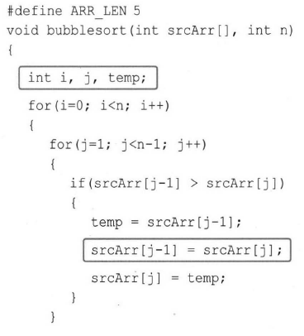
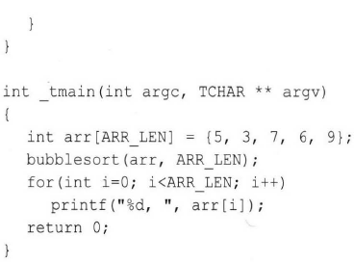
Example of Locality
Temporal Locality
i, j, temp
Refers to the reuse of data/resource
Repeatedly accessed
Spatial Locality
srcArr[j-1] = srcArr[j]
Refers to the use of data elements within relatively close storage locations.
Sequential Locality
Temporal Locality
Spatial Locality
Notes:
This is bubble sort algorithm.

Slide 13
Summary
Memory
Register > Cache > Main Memory > Hard Disk
Cache
Temporal Locality
Cache will hit again the data that already is used
Spatial Locality (Block)
Hard Disk
ALU
Register
Cache Miss
Cache Hit
L1 Cache
Cache Miss
L2 Cache
Main Memory

